Slide 1
Vehicle Detection
Arron Bao B. Van, Zhaozhuo (Alan) Li
CS484, Fall 2015

Slide 2
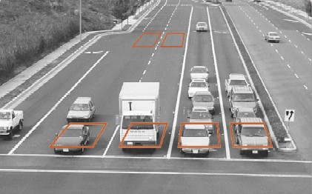
Problem: Detect Cars on Road
OpenCV
Background Subtraction, k-NN method
Simple Blob Detection

Slide 3
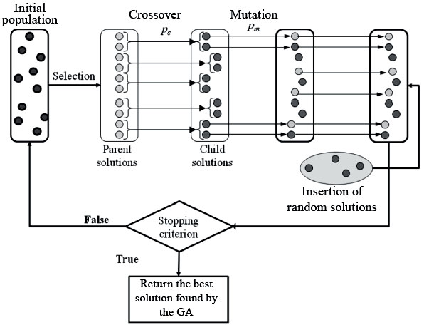
Problem 2: Blob Detection is meh
Don’t change methodology
Improve by changing blob detector parameters

Slide 4
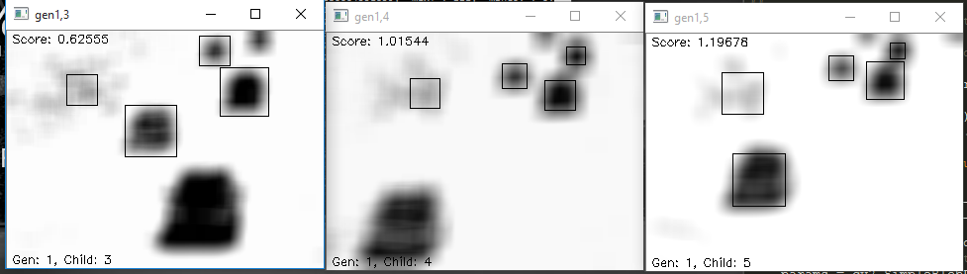
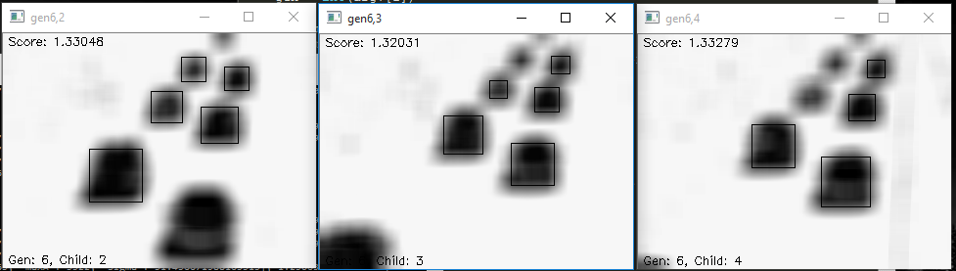
Results

Slide 5
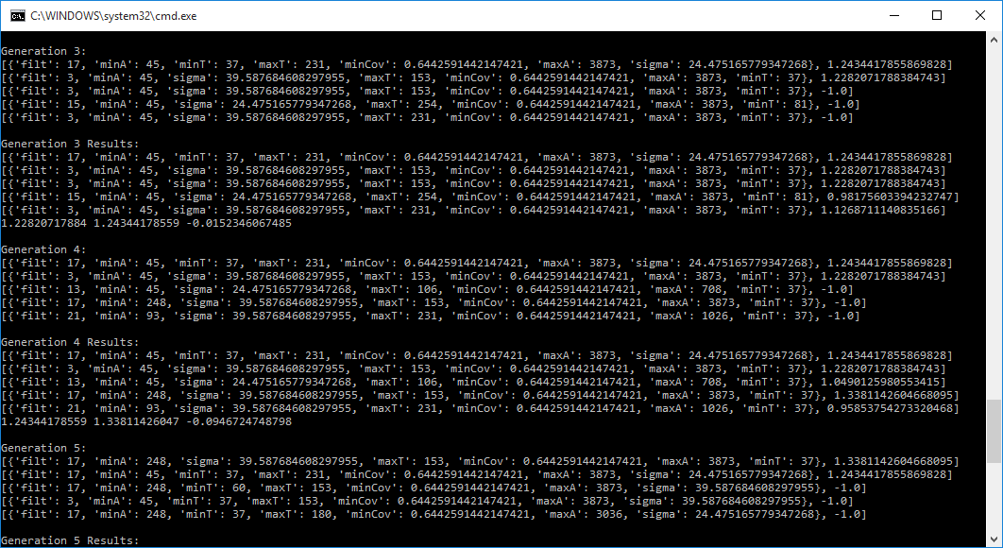
Results

Slide 6
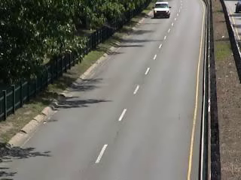
Results
http://www.changedetection.net/
https://github.com/Screensaver7/Genetic-Vehicle-Detection
10 generations with max population of 8.

Slide 7
Problems
This assumes that videos has efficient lighting and conditions…

Slide 8
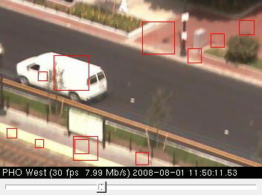
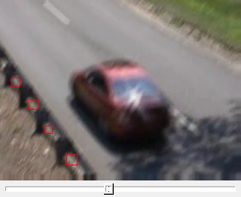
Problems
Shaking Camera

Slide 9
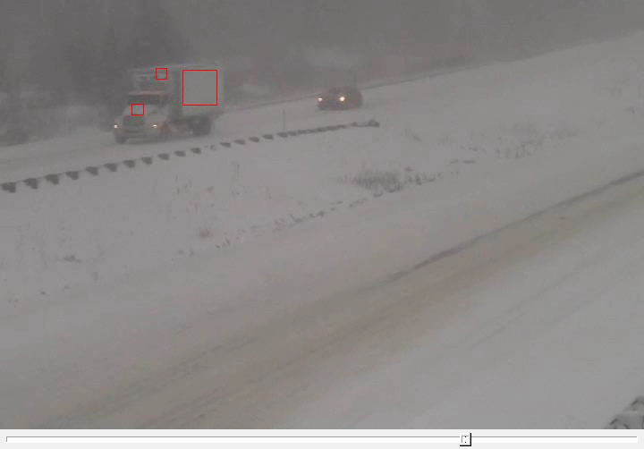
Problems
Bad Weather

Slide 10
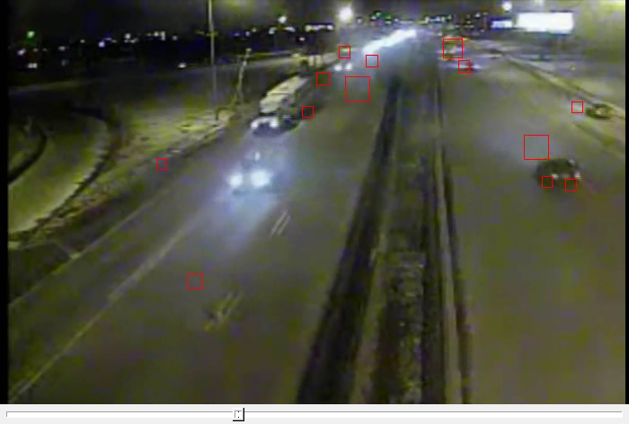
Problems
Dark Lighting

Slide 11
Conclusion
Works well on single instances
Over fits training data
Bad at generalization
Not enough test sets?

Slide 12
Work
Arron Bao B. Van – 35%, BG subtract, Blob Detect
Zhaozhuo Li – 65%, Bbox, Accuracy measurements, Genetic Algorithm, Report, Presentation
Pepperoni and pineapple pizza with sausages – Moral support

